Slide 1
Smart Attendance Marking System using Face Recognition
Project Supervisor:
Dr. Ruchi Verma
Presented by:
Group No.-86
Abhinav Sharma 171297

Slide 2
CONTENTS
Introduction
Objective
Tools Used
Literature Survey
LBPH
Facial Features
Design Flow
Steps for Image Processing
Advantages
Limitations
Future Scope
Conclusion
References

Slide 3
Introduction
Maintaining attendance is very important in all educational institutions. Every institution has its own method of taking student attendance. Some institutions uses paper based approach and others have adopted automated methods such as fingerprint biometric techniques. However, these methods subjects students to wait in a queue which consumes time and it is intrusive.
Humans often use faces to recognize individuals but advancement in computing capability over the past few decades now enable similar recognitions automatically. Face recognition technology is one of the least intrusive and fastest growing biometric technology. It works by identification of humans using the most unique characteristics of their faces. Face recognition has characteristics that other biometrics do not have. Facial images can be captured from a distance and any special action is not required for authentication.
Notes:
Face recognition is the process of identifying one or more people in images or videos by analyzing and comparing patterns. Algorithms for face recognition typically extract facial features and compare them to a database to find the best match.

Slide 4
Objective
The proposed system that is, Smart Attendance Marking System using Face Recognition would be developed such that the Faculty can add student data and along with it train the model for face recognition. Further the model will be used to mark attendance as it would recognize the students present in the class and then mark their presence on Excel sheet.
The face recognition is an integral part of biometrics. In biometrics, basic traits of human are matched to the existing data. Facial features are extracted and implemented through algorithms, which are efficient and some modifications are done to improve the existing algorithm models. Computers that detect and recognize faces could be applied to a wide variety of practical applications including criminal identification, security systems, identity verification etc. The face recognition system generally involves two stages:
Face Detection – where the input image is searched to find any face, then image Processing cleans up the facial image for easier recognition.
Face Recognition – where the detected and processed face is compared to the database of known faces to decide who that person is.

Slide 5
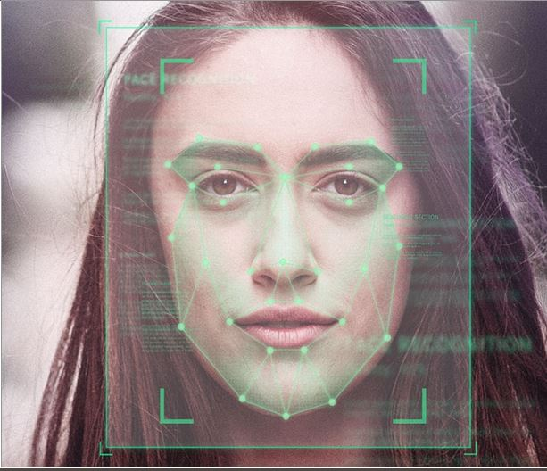
Tools Used
Visual Studio Code
Python
Pandas
OpenCV
Numpy
Openpyxl
Tkinter

Slide 6
Literature Survey
There are models that have been designed which are capable of marking the attendance of students through image processing. Analyzing various research papers we aim to find the solutions provided by others author and consider the imperfection of the system proposed by them and give the best solutions possible. The most commonly used algorithms were Principal Component Analysis(PCA) and Local Binary Patterns Histograms (LBPH). Among all other algorithms used these two proved out to be the best for the problem statement with certain limitations that PCA provided therefore for now we went on to work with LBPH for our solution to the problem statement.

Slide 7
Design Flow
Image Acquisition
Image Processing
Extraction of Facial Features
Marking Attendance
Comparing with Database

Slide 8
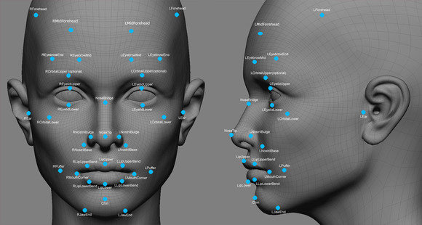
Notes:
Each human face has 80 nodal points. Facial recognition software will analyze the nodal points such as the distance between your eyes or the shape of your cheekbones.

Slide 9
Steps for Image Processing
Acquire RGB Image
Convert RGB Image to Grayscale
Apply Detection
Recognize face
Resize extracted face image
Extract face from image

Slide 10
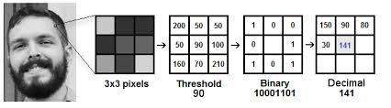
Local Binary Patterns Histograms (LBPH)
LBPH is a widely used face recognition algorithm provided by OpenCV Library due to its computational simplicity and discriminative power. It is based on local binary operator. In LBPH each image is analyzed independently and this algorithm is capable enough to recognize both side as well as front faces and also this algorithm is better in different environments and light conditions .It also depends on our training and testing data sets.

Slide 11
Advantages
Proxy attendance is eliminated.
It saves time and effort.
The faces are stored and then attendance is marked for the recognised faces automatically.
This is a convenient system.

Slide 12
Limitations
Lighting conditions mas sometimes be a problem. In a very low light system may not be able to detect faces with the best accuracy.
The line of sight and the angle of sight of a camera is limited therefore camera that we use may become reason for limitation.
For now the system marks present of people even if shown a photo from phone.

Slide 13
Conclusion
An automatic attendance management system aims at solving the issues of manual methods of existing systems. They use the concept of face recognition to implement a system that marks the attendance of a particular person by detecting and recognizing the face. These systems perform satisfactorily with different facial expressions, lighting and pose of the person.
There is room for improvement and we would try our level best to overcome those limitations with the model that we would present.

Slide 14
Future Work
Introduction of student portal into the system where the student may check their attendance.
Changes in GUI making it more appealing.

Slide 15
References
http://www.willberger.org/cascade-haar-explained/
https://towardsdatascience.com/face-recognition-how-lbph-works-90ec258c3d6b
Fawaz, A. (2019). A smart classroom of wireless sensor networks for students time attendance system. In IEEE integrated STEM education conference (ISEC).
Li, J., Gu, J., Huang, Z., & Wen, J. (2019). Application research of improved YOLO V3 algorithm in PCB electronic component detection. Applied Sciences,9, 3750.
Shoewu, O., & Idowu, O. A. (2012). Development of attendance management system using biometrics. The Pacific Journal of Science and Technology,13(1), 300–307.

Slide 16
THANK YOU!!!

